Slide 1


Slide 2
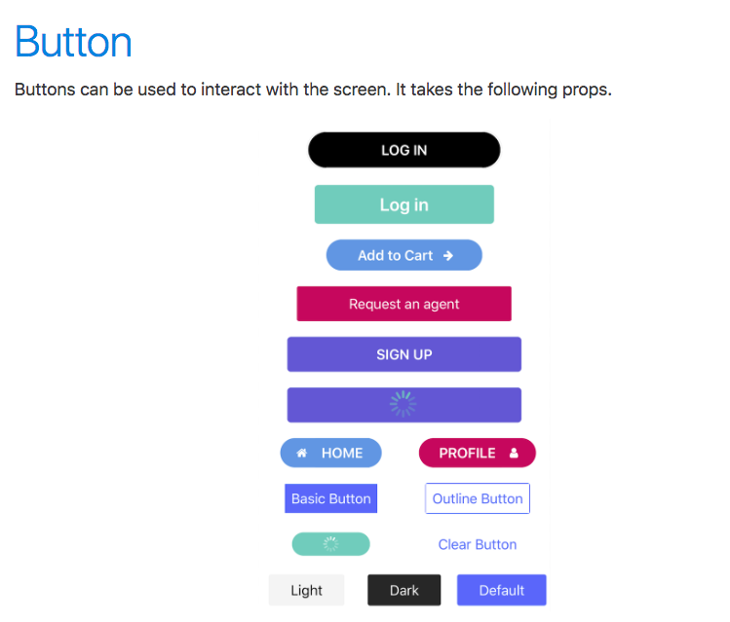

Slide 3
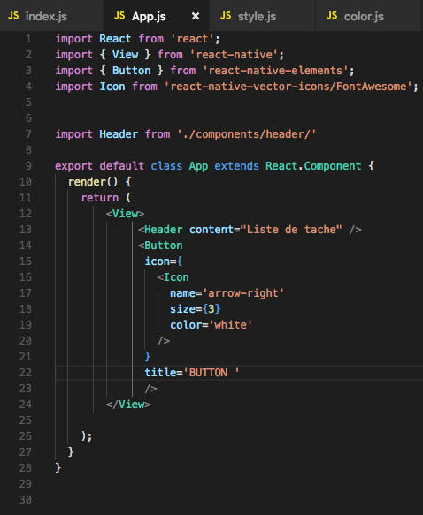
Configuration basic ‘react-native-elements’

